Slide 1
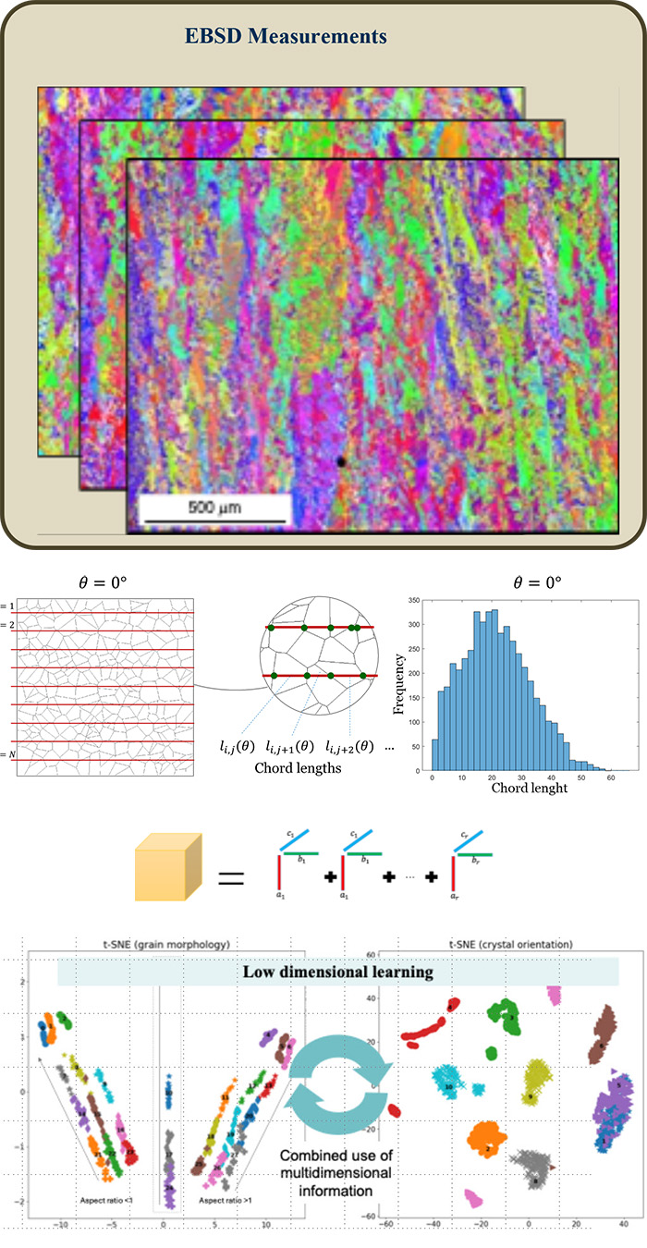
H. Milton Stewart School of Industrial and Systems Engineering
Georgia Tech
Automated Characterization of Microstructure Data in Additive Manufacturing via Low-Dimensional Learning
PI
Sponsor
Kamran Paynabar
Sponsor
Motivation & Problem Description
Objective
Microstructural properties, including grain morphology and crystal orientation, impact mechanical performance and consistency.
Visual analysis and synthetic descriptors of both grain morphology and crystal orientation.
Using separate methods for morphology and RGB intensity maps for orientation.
Develop a learning framework by integrating grain morphology and crystal orientation data for a microstructure characterization and classification.
Multi-feature embedding using KDE.
Manifold learning.
Tensor analysis.
Developed Solution
Impact
Multi-feature embedding using KDE.
Manifold learning.
Tensor analysis.
Improving performance by automation.
Increasing accuracy.
Enabling classifying segments effectively.
Paper / Publication
Website / URL
Author(s), "Title of Paper," Journal / Conference Name, Year.
https://www.example.com/related-resource

